Slide 1

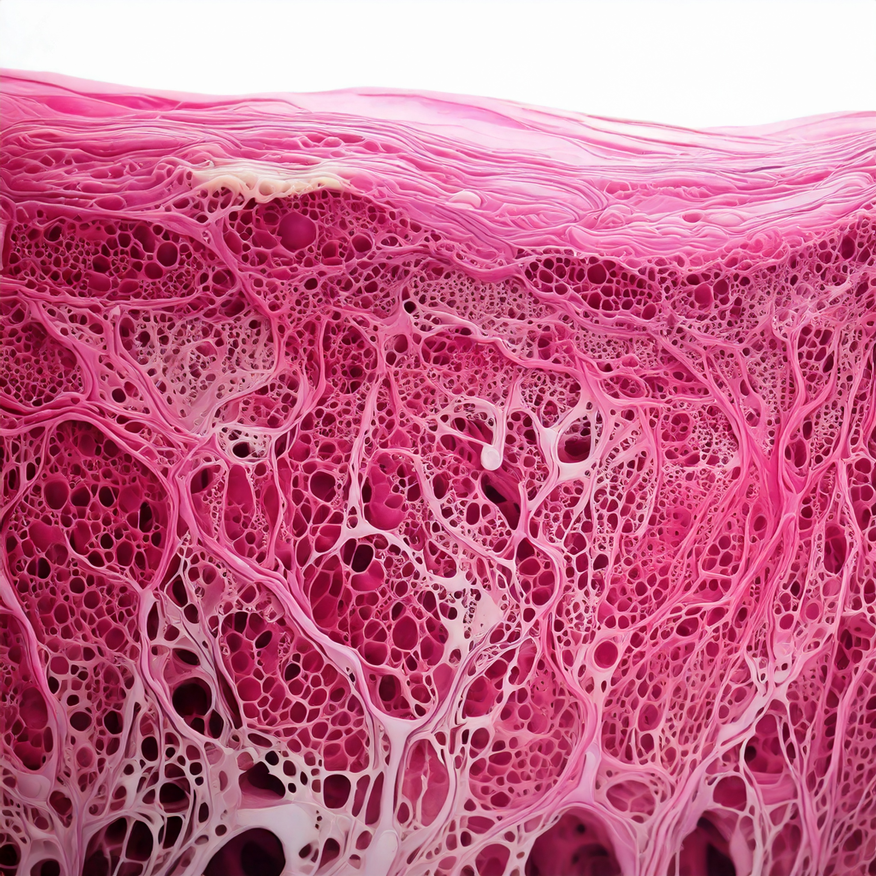
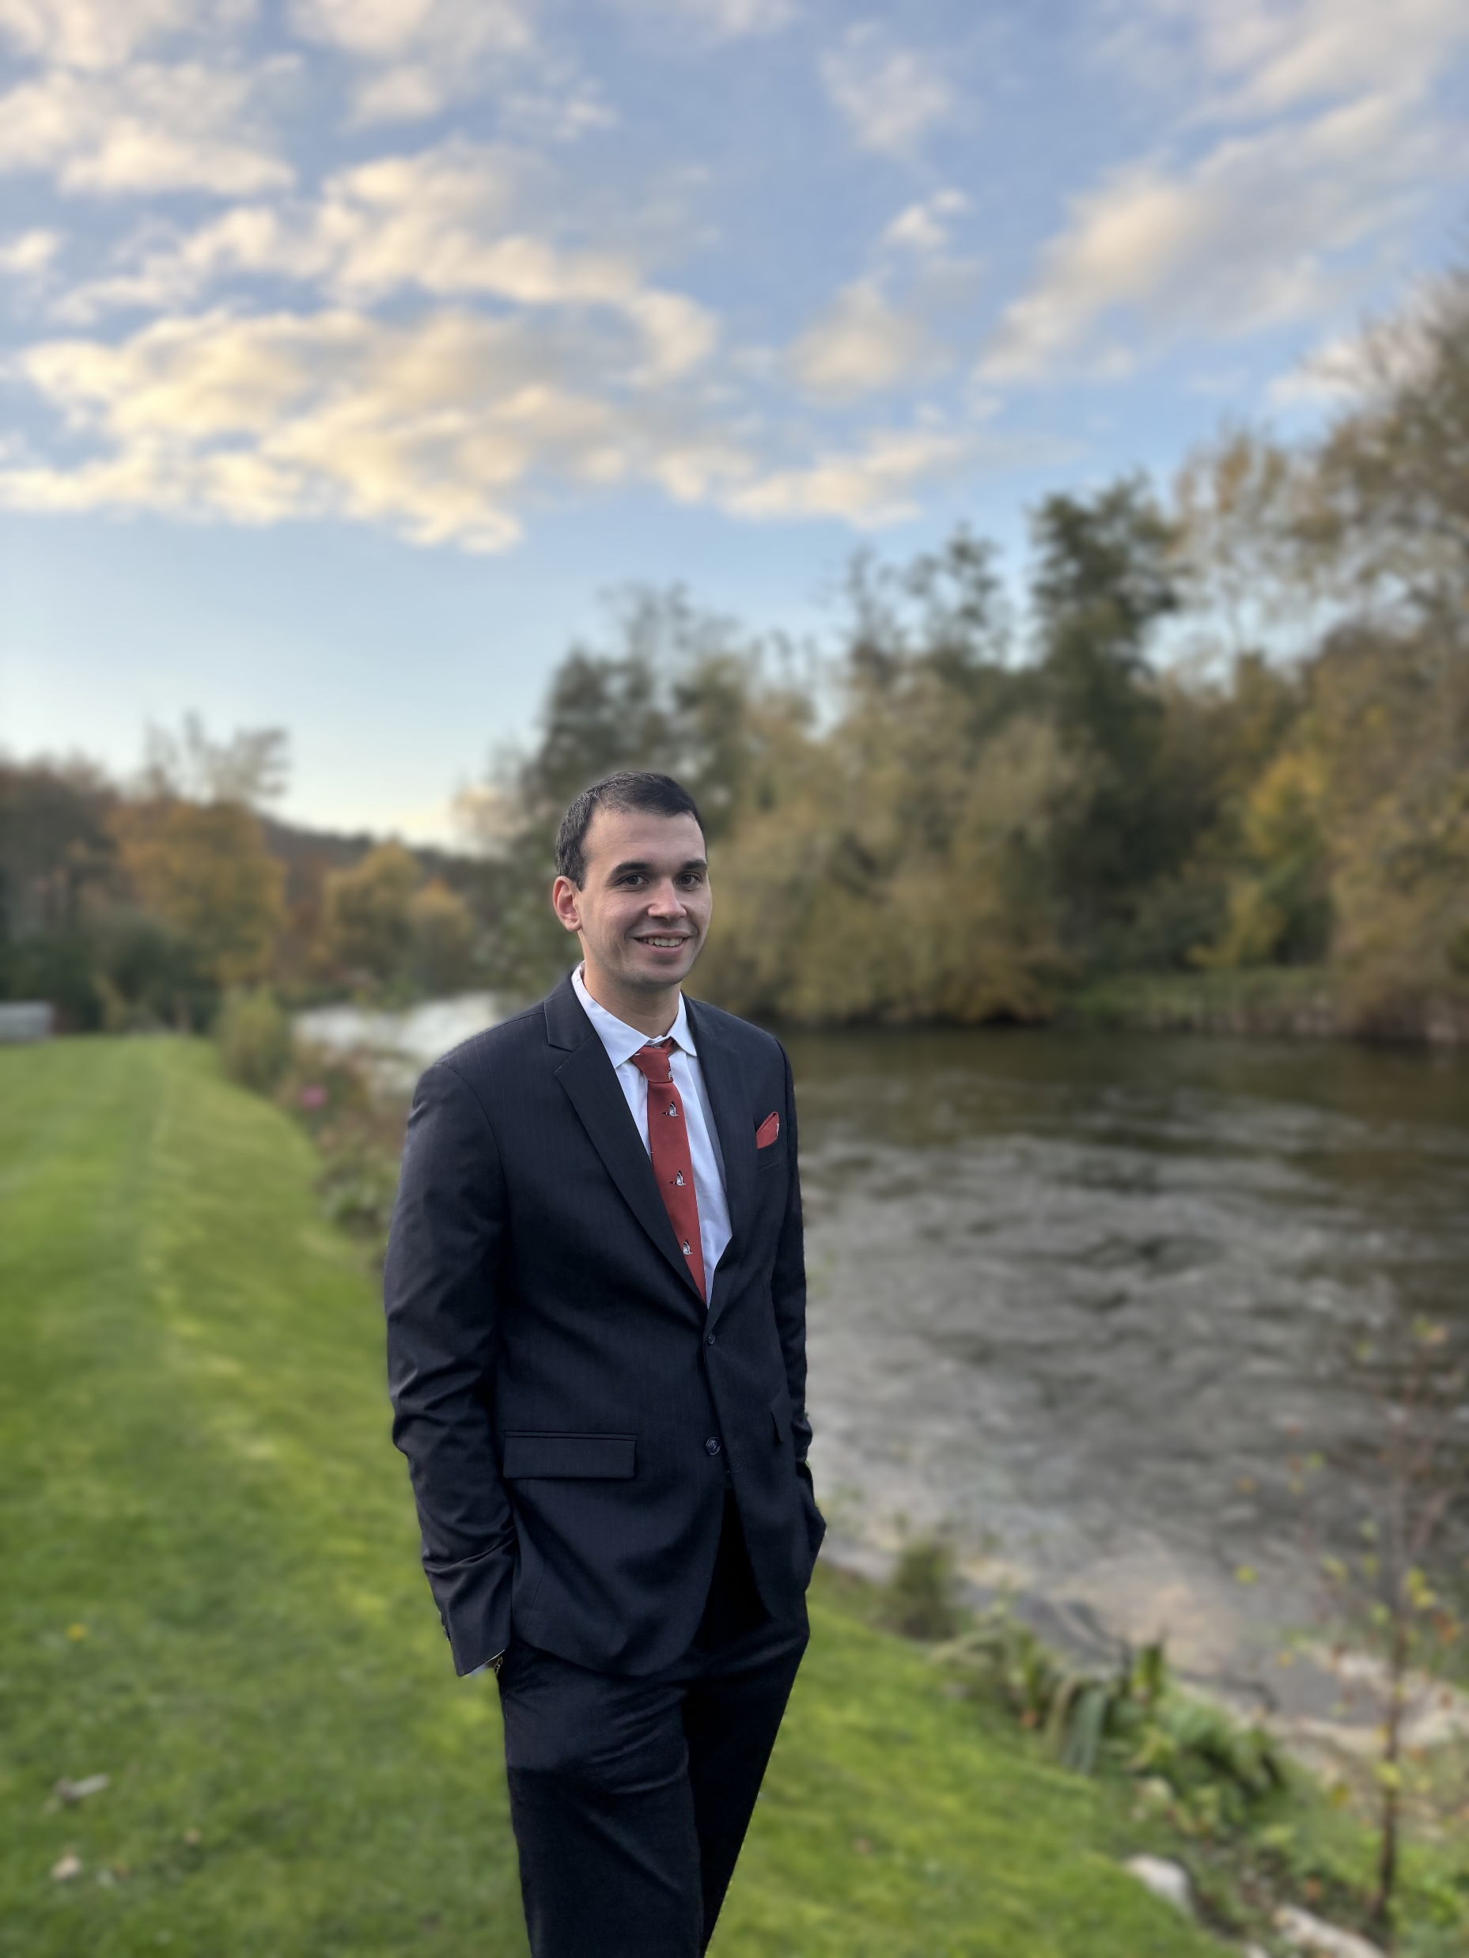

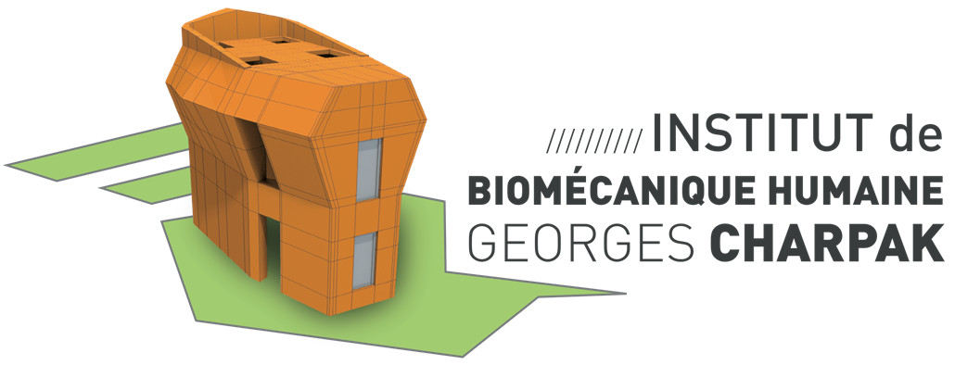
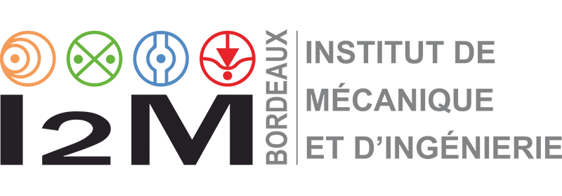
Thomas Lavigne – Docteur en Sciences de l’Ingénieur
Thomas LAVIGNE
Biomechanical Response of Human Skin: A Hierarchical Porous Media Framework.
Supervisors
Pr. S. Bordas, Dr. P-Y. Rohan, Dr. G. Sciumè
AFR-FNR 17013182

Slide 2

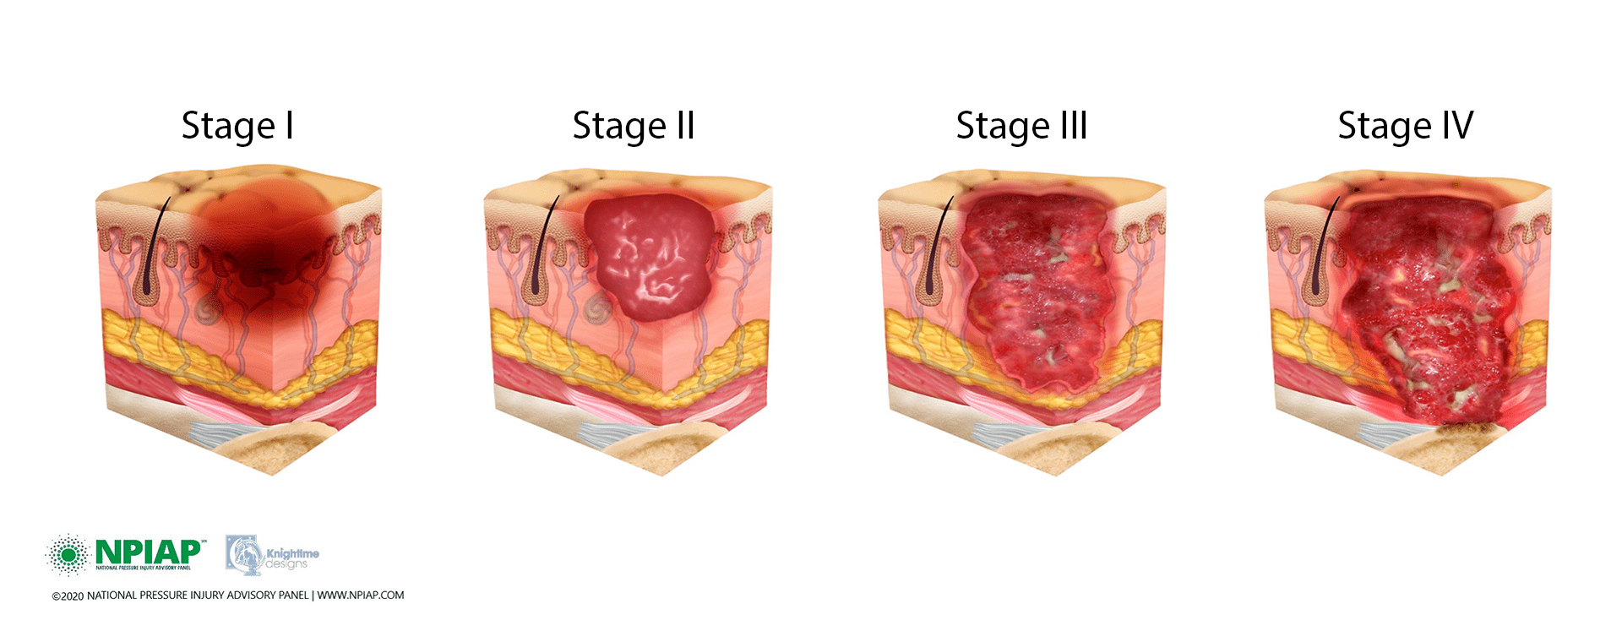












Pressure ulcers
[Vanderwee et al., 2007]
[Ayello 2008; Parvizi et al. 2023]
Notes:
30 seconds
Pressure ulcers: localised injuries to the skin and underlying soft tissue that form during prolonged exposure to mechanical loads [NPIAP].
Pressure ulcers are a major burden globally 1/5 in Europe and almost ½ worldwide
"Fundamentally, this condition is preventable, but it requires a deeper understanding of the biomechanical limits of the human body."
Pressure ulcers (PUs) typically fall just below the top tier of the most expensive chronic diseases. In fact, some sources from that period stated that pressure ulcers were the third most costly disease after cancers and cardiovascular diseases.
Key Takeaway
While the total annual cost of PUs is massive, it is dwarfed by the spending on major, population-wide chronic conditions like heart disease, cancer, and diabetes.
However, PUs are notable for two reasons:
They are considered a "Never Event": The costs are largely for complications that are deemed preventable, making the $9.1–$11.6 billion a highly scrutinized and often unreimbursed expense for hospitals since 2008.
Per-Case Cost is Astronomical: The individual cost to treat a single advanced pressure ulcer can range from $20,900 to over $150,000, making them incredibly costly on a per-patient basis.¹

Slide 3

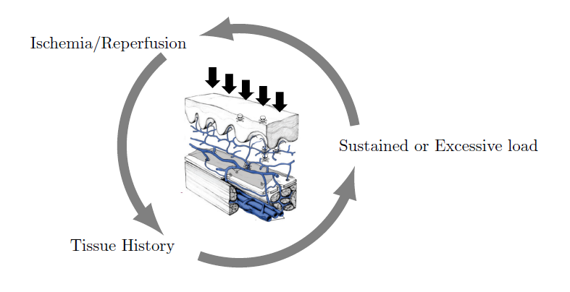
Clinical research
Oxygen deprivation
External forces
State of the tissue
Notes:
Research into PU etiology has revealed several tangible quantitative risk factors, including biological factors like oxygen deprivation, sustained external mechanical loads, and the overall condition (or history) of the tissue.

Slide 4
Clinical research: interplay ?
Oxygen deprivation
External forces
State of the tissue
Notes:
However, these factors are still generally studied separately, despite the fact that they significantly influence one another.

Slide 5
A skin porous model compared to patient data: a comprehensive tool for understanding the bidirectional link between mechanical integrity and microvascular health.
Notes:
To close this gap, my research proposes a porous model of the skin, compared to patient data, as a comprehensive tool for understanding the bidirectional link between mechanical integrity and microvascular health.

Slide 6
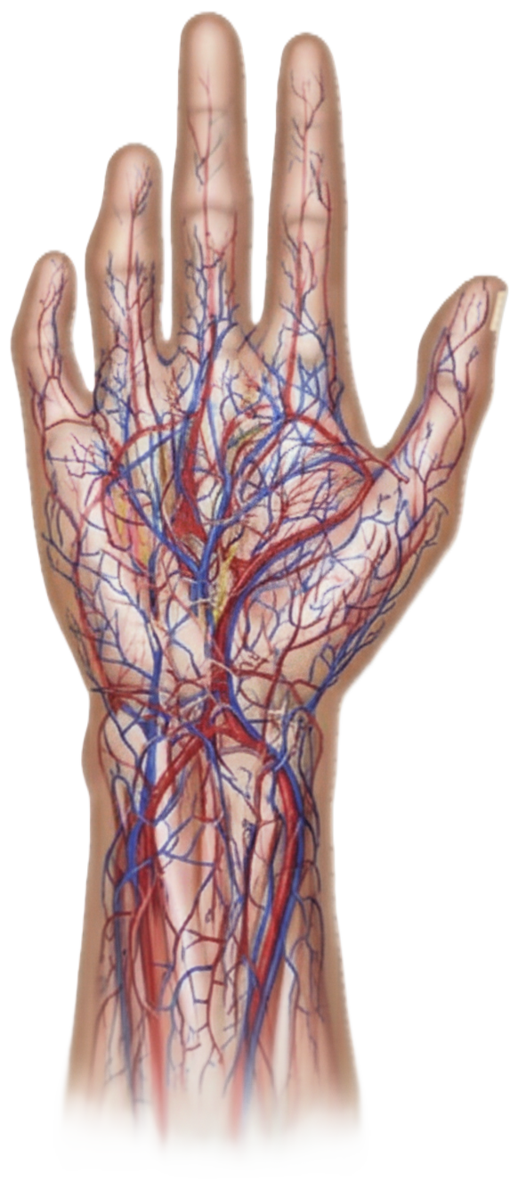
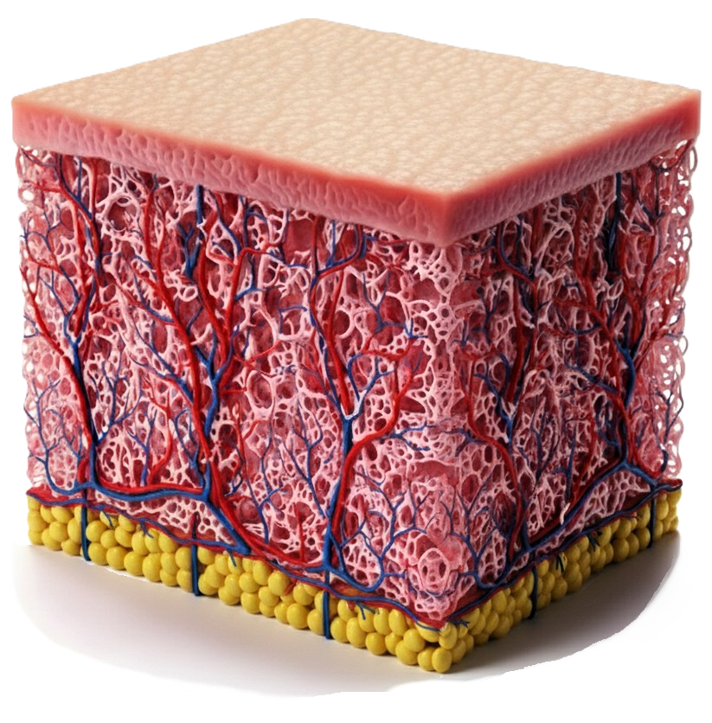
The Human skin as a sponge
Macroscale
Stratified
Fibrous
60% of water
[Burns et al., 2010]
Some images are AI generated
Notes:
Looking closer, the skin is a stratified tissue, including the epidermis and the dermis. Critically, it is composed of almost 60% of water. Therefore, we can think of it as a sponge with an external impermeable layer.

Slide 7
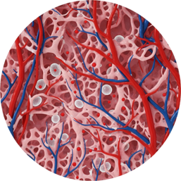
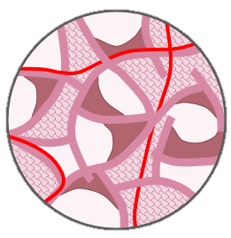

The Human skin as a sponge
Microscale
Interstitial fluid
Mobile cells
Structural cells and other structures
Connective tissue
Micro-vascular system = oxygen supply
$$≃$$
Some images are AI generated
Notes:
At the microscale, biology is visible through the presence of fluids in the pores conducting oxygen and nutrients from blood to cells. Constructing the model is assuming a simplified version of it.

Slide 8
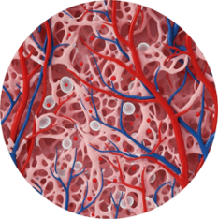
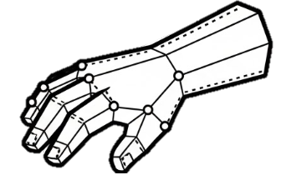
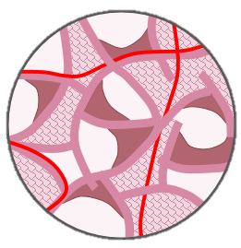




The Porous (bricks) Model
Conservation Laws
Constitutive Laws
Mass Conservation
Solid
Stress-Strain law
How does it work?
Increasing force on the solid
Increased pressure in the pores
Squeezed blood vessels
Solid
Cells
Oxygen
Pores
IF
Blood
IF pressure / Cell Saturation
F(x, p^{α}) =
Force Equilibrium
Vascular phase
Porosity
Permeability
Total stress
Darcy Blood
Oxygen
Darcy IF
Darcy Cells
Diff. Oxygen
Abs. Oxygen
[Lavigne et al. 2023, 2025a, 2025b , 2025c]
Notes:
To build the model itself, two types of equations are used: first, the well-established conservation laws of mechanics, which govern force equilibrium and mass conservation ; and second, the constitutive laws, where we introduce our specific hypotheses to model the interaction between the different phases as “brick” components: XXXX. But how does it work ? An extertnal force on the skin stresses the tissue and create micro-displacements of its components. Then, this stress is transfered to the pores where fluid movement and compression transmitted from the macroscopic scale disrupt the microvascular network, cutting off oxygen supply to the tissue.

Slide 9
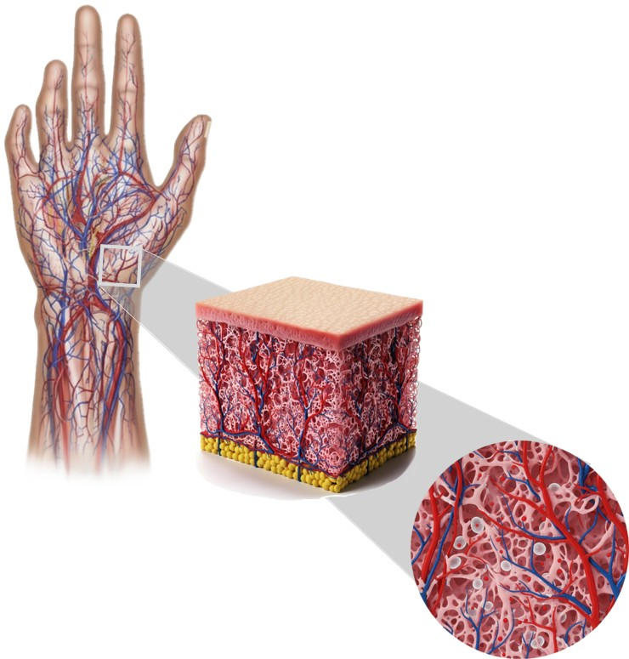
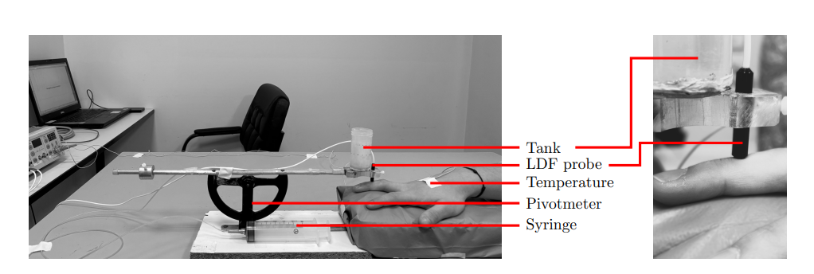
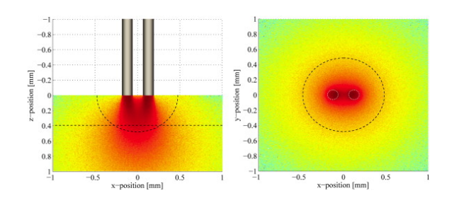
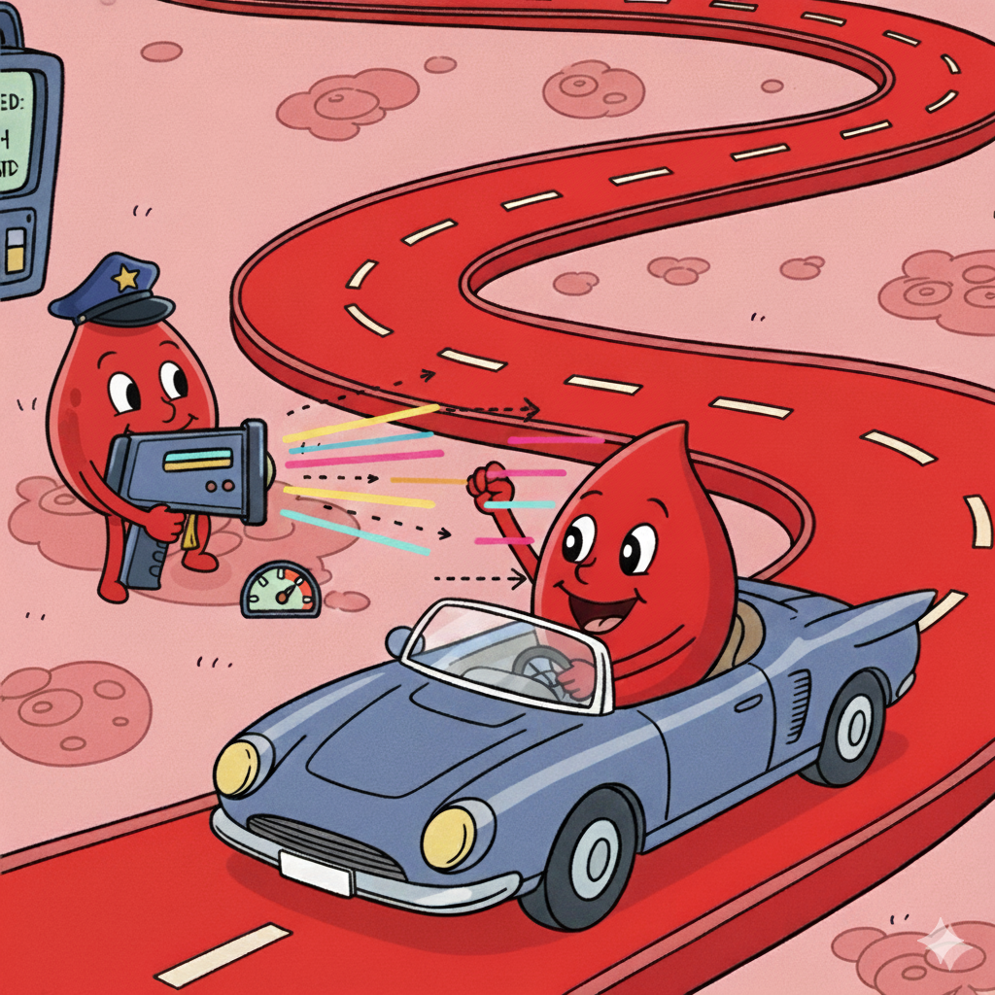

Experimental setup
[Fredriksson et al., 2009]
N= 11 N= 10
Some images are AI generated
Notes:
We recruited 11 males and 10 females patients and measured the laser doppler flowmetry on the finger. The external force was direclty applied on top of the probe to properly capture the interplay between mechanics and biology. But what is LDF, just like radars for cars, the idea is to use the so-called Doppler effect to measure the red blood cell velocity, reduced flow revealing lower values and vice-versa. Notably, no significant difference was observed between men and women.

Slide 10
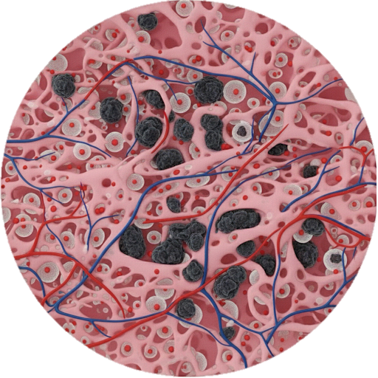
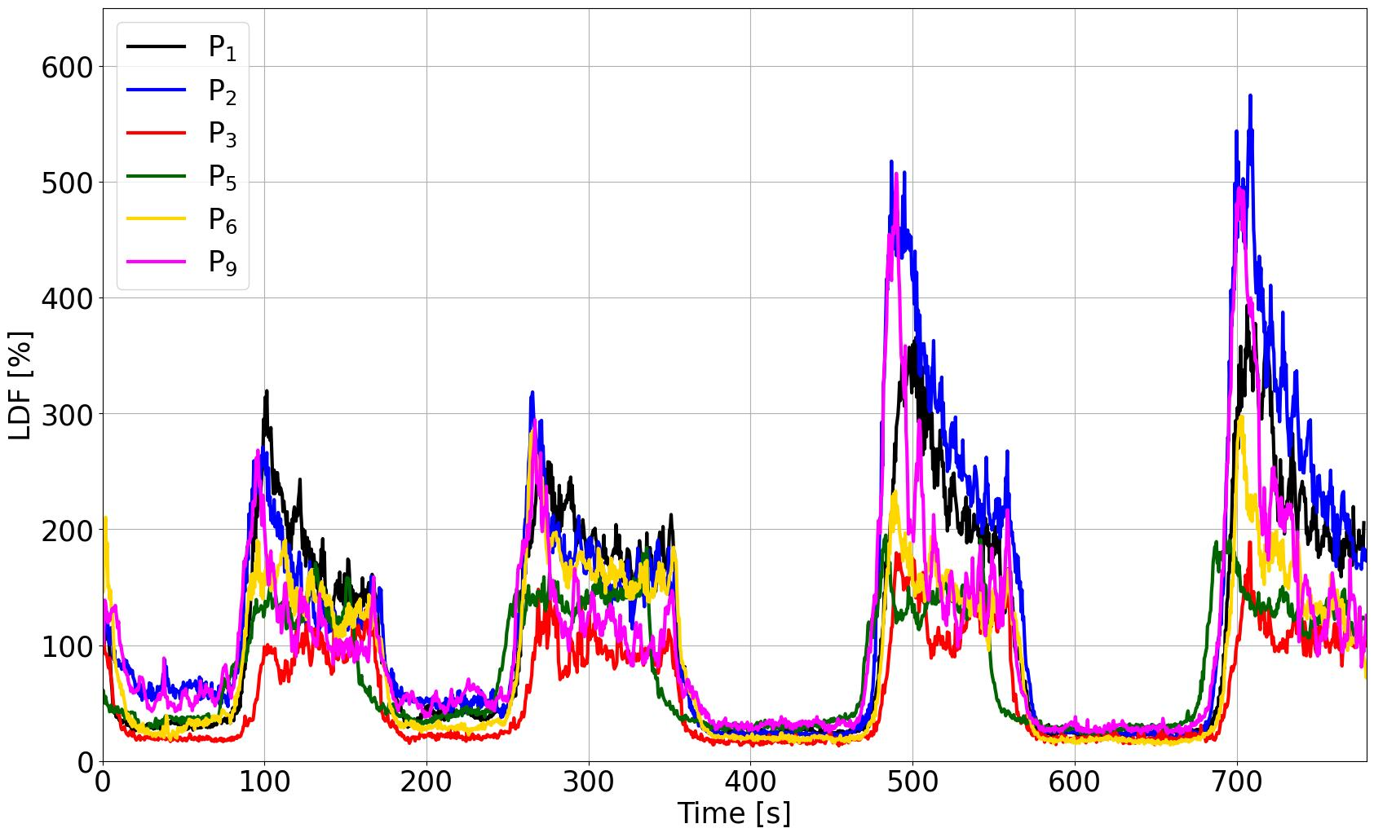
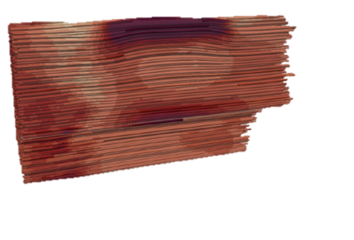
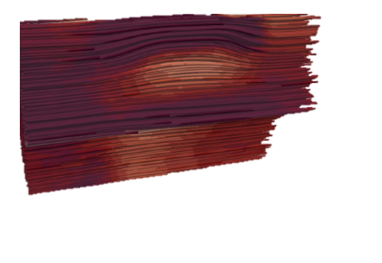
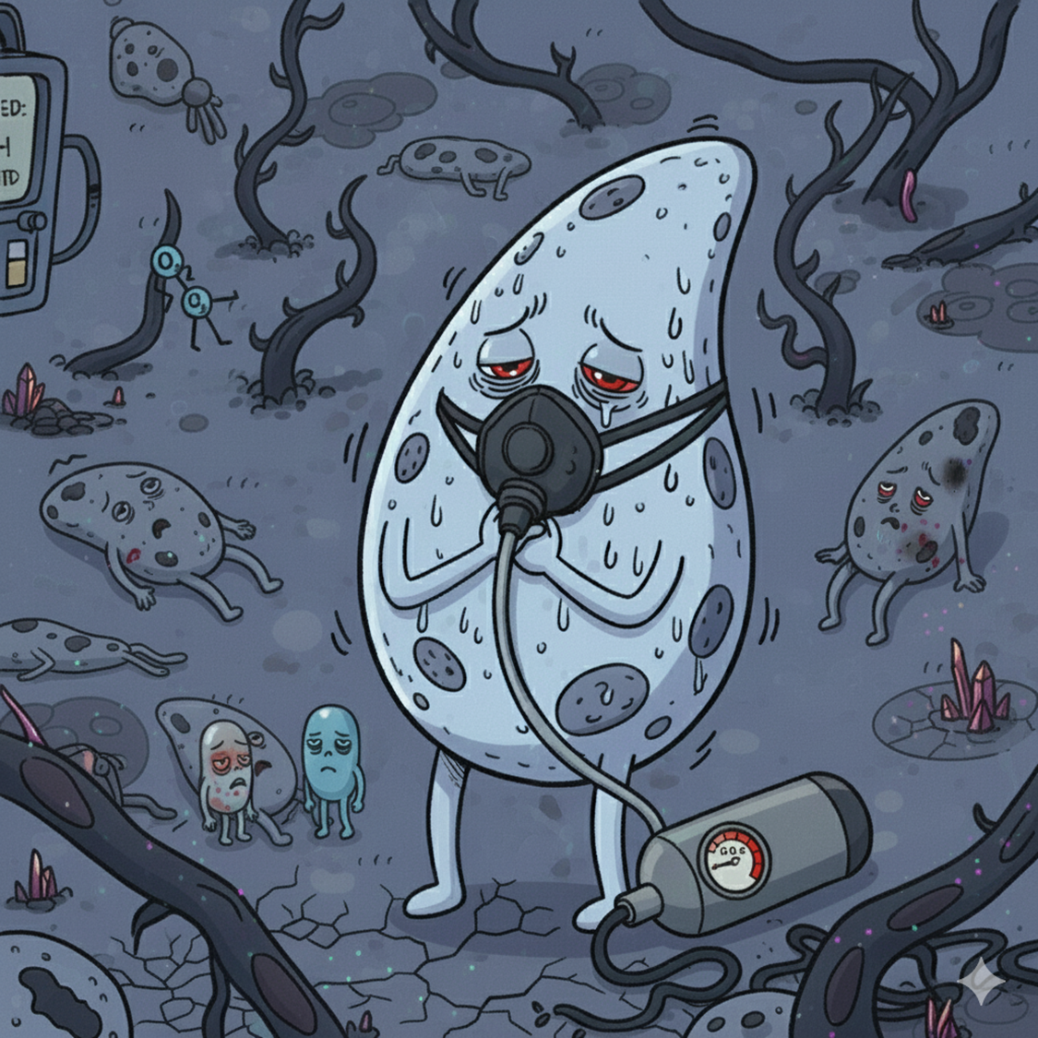
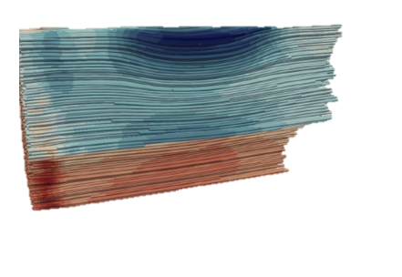
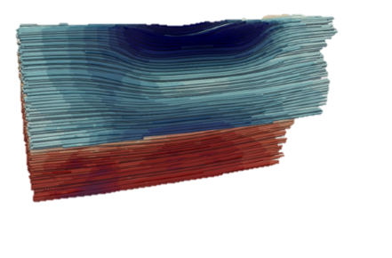
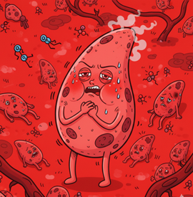
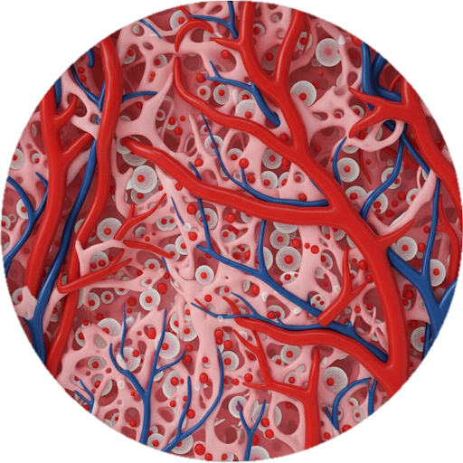
Model vs Patient data
Ischaemia (Hypoxia)
Hyperemia (Oxydation – Water-hammer pulse)
Some images are AI generated
Notes:
Here are typical experimental curves. As we expected, we observe two different behaviors.
The first is Ischemia (Hypoxia), where applying an external load reduces the blood vessel sections
Conversely, releasing the load, we observe hyperemia which is a Water-hammer pulse

Slide 11
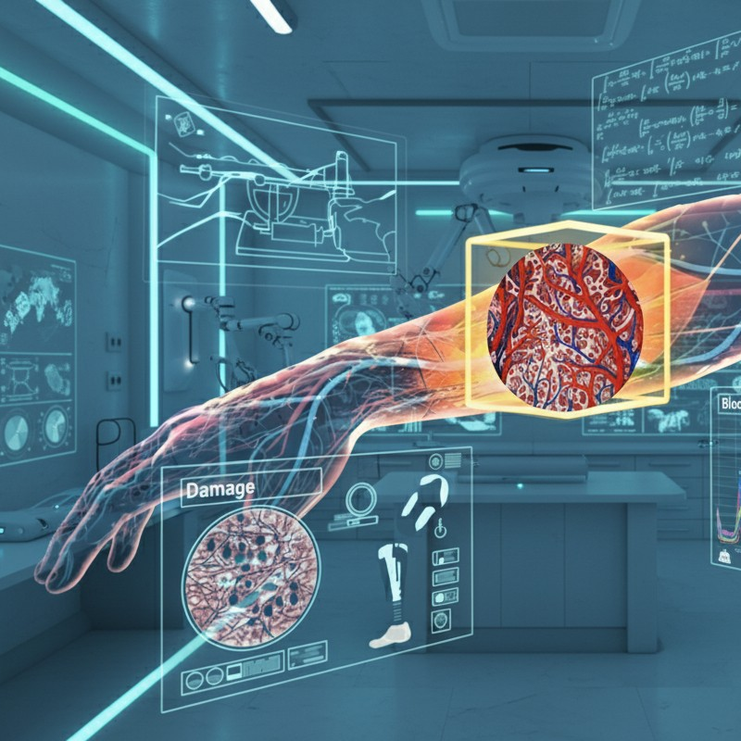

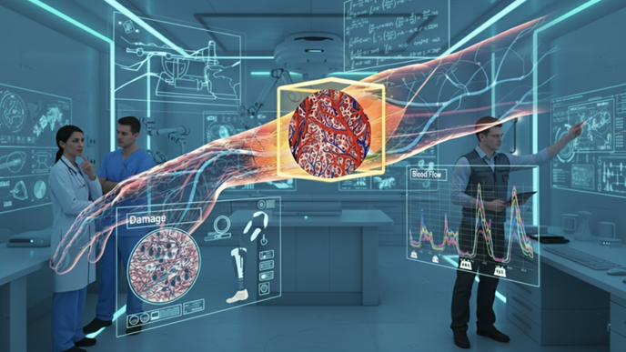
Perspectives
Towards Personnalized Treatment
Conservation Laws
Constitutive Laws
Mass Conservation
Solid
Solid
Cells
Oxygen
Stress-Strain law
IF
Blood
Interstitium
F(x, p^{α}) =
IF pressure / Cell Saturation
Force Equilibrium
Vascular phase
Total stress
Darcy Blood
Porosity
Permeability
Darcy IF
Darcy Cells
Oxygen
Diff. Oxygen
Abs. Oxygen
Some images are AI generated
✔ Hierarchical and Modular porous framework,
✔ Ischaemia and PORH were obtained with mechanics only,
✔ Open-source implementation,
✔ Transferable: plantar foot, brain, tissue engineering, drug delivery, ➪ Biological integration should be compared to experimental campaigns,
➪ For pressure ulcers prevention, damage and remodelling should be introduced,
Notes:
By clearly defining these couplings, we gain the ability to precisely identify physiological weak points, which directly enables the creation of more accurate and highly individualized therapeutic strategies.

Slide 13

Ayello, C. H. L. E. A. (2008). “Patient Safety and Quality: An Evidence-Based Handbook for Nurses.” In: NIH. Chap. 12.
Lavigne, T., S. Urcun, P.-Y. Rohan, G. Sciumè, D. Baroli, and S. P. Bordas (2023). “Single and bi-compartment poro-elastic model of perfused biological soft tissues: FEniCSx implementation and tutorial”. In: Journal of the Mechanical Behavior of Biomedical Materials 143, p. 105902
Lavigne, T., S. Urcun, E. Jacquet, J. Chambert, A. Elouneg, C. A. Suarez-Afanador, S. P. A. Bordas, G. Sciumè, and P.-Y. Rohan (2025a). Poromechanical modelling of the time-dependent response of in vivo human skin during extension. In: International Journal for Numerical Methods in Biomedical Engineering.
Lavigne, T., S. Urcun, B. Fromy, A. Josset-Lamaugarny, A. Lagache, C. A. Suarez-Afanador, S. P. A. Bordas, P.-Y. Rohan, and G. Sciumè (2025b). “Hierarchical poromechanical approach to investigate the impact of mechanical loading on human skin micro-circulation”. In: International Journal for Numerical Methods in Biomedical Engineering.
Lavigne T, Biomechanical Modeling of Human skin: a Hierarchical Porous Media Framework. PhD, Biomechanical Response of Human Skin : A Hierarchical Porous Media Framework. | Theses.fr
Fredriksson, I., M. Larsson, and T. Strömberg (2009). “Measurement depth and volume in laser Doppler flowmetry”. In: Microvascular Research 78.1, pp. 4–13.
Parvizi, A., S. Haddadi, A. Mollaei, P. Ghorbani Vajargah, P. Takasi, M. Firooz, S. J. Hosseini, R. Farzan, and S. Karkhah (2023). “A systematic review of nurses’ knowledge and related factors towards the prevention of medical device-related pressure ulcers”. In: International Wound Journal 20.7, pp. 2843–2854.
Vanderwee, K., M. Clark, C. Dealey, L. Gunningberg, and T. Defloor (2007). “Pressure ulcer prevalence in Europe: a pilot study”. In: Journal of Evaluation in Clinical Practice 13.2, pp. 227–235

Slide 14
Biomechanical Response of Human Skin: A Hierarchical Porous Media Framework.
Thomas Lavigne
Supervisors: S. Bordas, P-Y. Rohan, G. Sciumè Jury and guests: C. Vincenot, S. Avril, Y. Payan, S. Budday, S. Laporte
AFR-FNR 17013182
Notes:
10 seconds
Good afternoon, everyone. My name is Thomas Lavigne, and I'm here today to present my work on the Biomechanical Response of Human Skin, specifically through the lens of a Hierarchical Porous Media Framework.

Slide 15
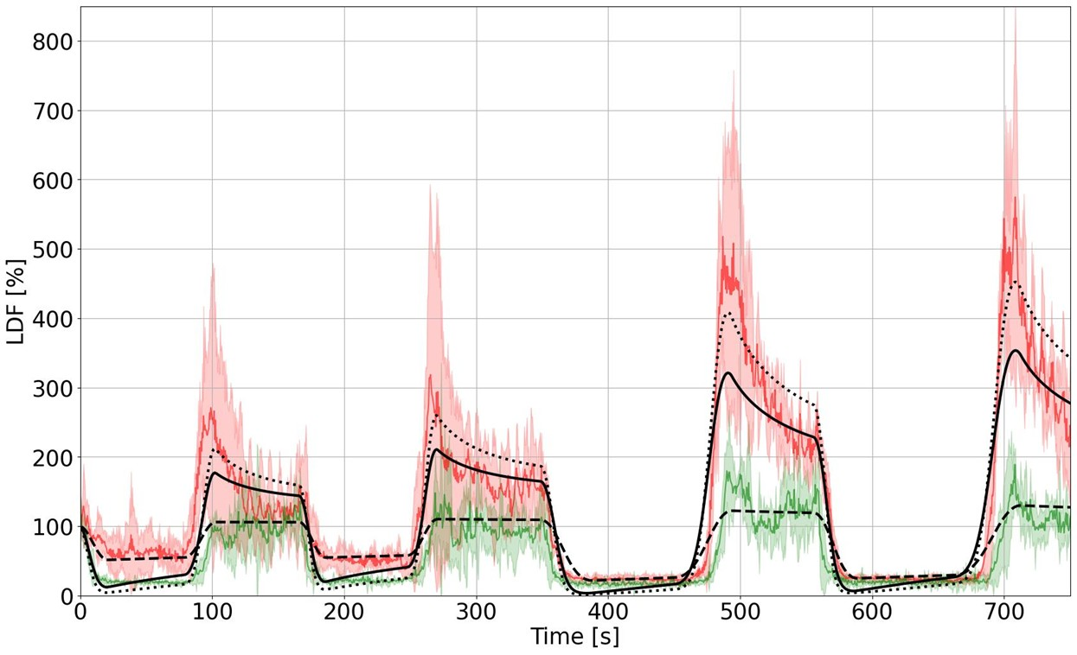
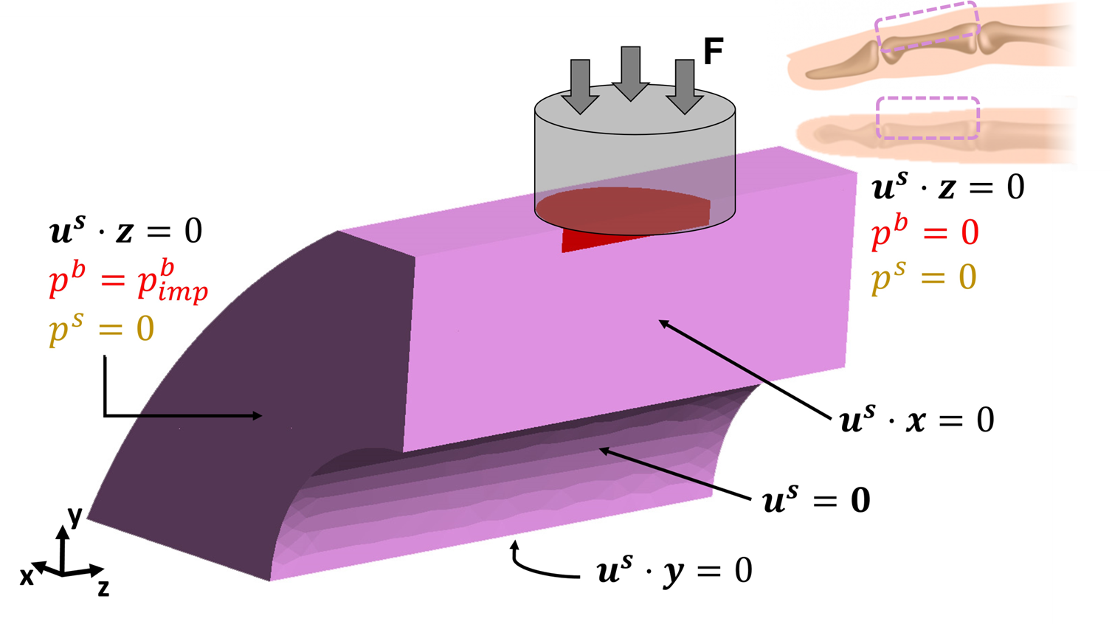
Evaluation with patient data
Notes:
Interestingly, the model was capable of representing both ischaemia and hyperemia, without any neurological considerations.

Slide 16








Thank you for your attention !
AFR-FNR 17013182
Notes:
Finally, I would like to express our deepest gratitude to the participants in these experiments. Without their commitment, these results could not have been achieved. We also thank everyone who contributed to this work, whose efforts we have tried to represent visually.

